Slide 1
Data Exploration:
Loaded the data and started exploring the data
There are 541 observations and 12 features in the dataset
Dropped the unnamed column which was not required
There were some null values in the datasets to deal with
Data types were alright
No missing missing values
There were duplicates values I dealt with.
There is some Null values that we need to deal with.
All the data types seem alright.

Slide 2
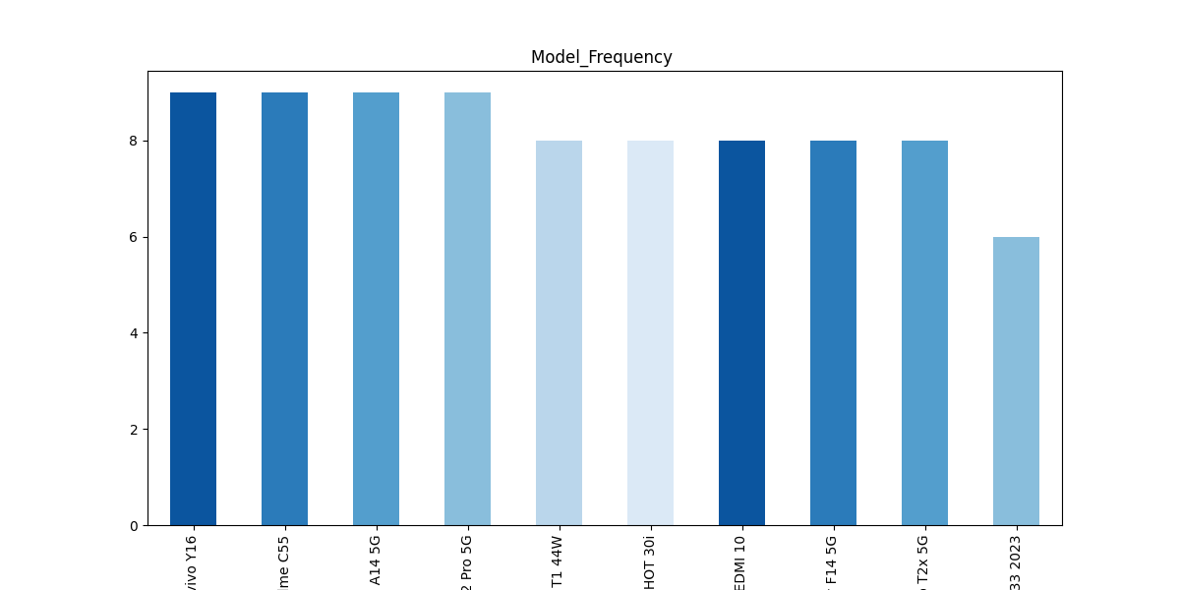
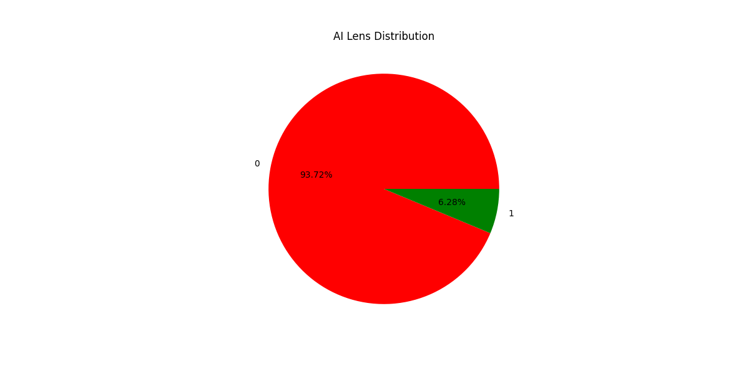
Data visualization :
Redmi Note 12 Pro, Vivo Y16 , realme C55 are the most frequent in the data
Only 7% of the phones have AI Lens

Slide 3
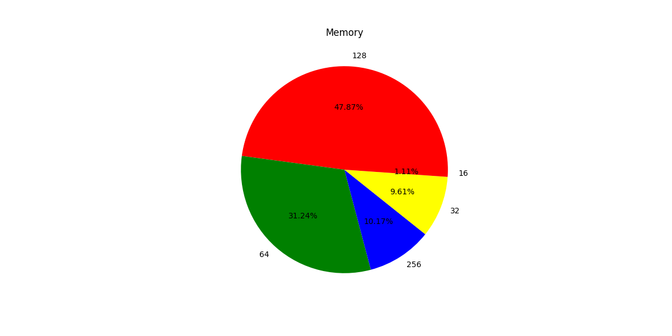
48% of the mobile phone have 128GB Memory

Slide 4
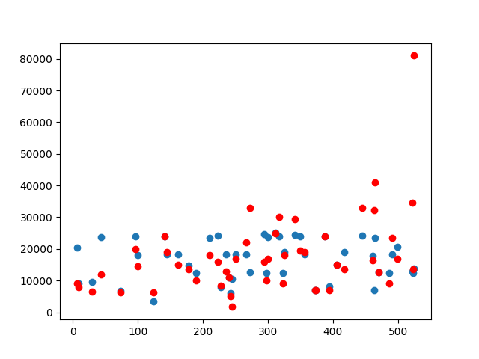
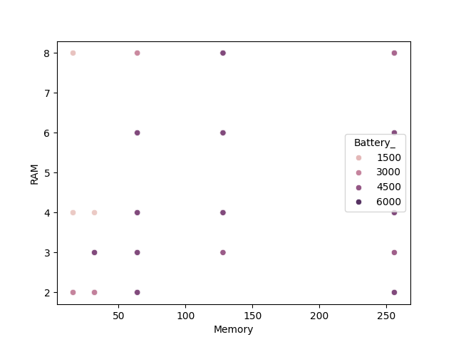

Slide 5
Feature Extraction:
We have extracted a prize feature of the mobile phones.
Our data is labelled (prize) so we will use supervised model
Our supervised data is numerical so we will perform Linear Regression
I have used Random Forest Regressor

Slide 6
Data Accuracy with Random Forest:
Training Accuracy: 1.0 %
Testing Accuracy: 0.82 %

Slide 7
Linear Regression:
Model 1 data accuracy is 85546342.41769049 %
Model 2 data accuracy is 69346957.50256658 %
Conclusion:
Model 2 is our best fit model

